Slide 1


Road To Machine Learning
Md. Mahfujur Rahman,
PhD Candidate, School of Information Systems

Slide 2

CONTENTS
What is Machine Learning?
Machine Learning VS Traditional Programming
Types of Machine Learning
Supervised Learning
Unsupervised Learning
ML VS DEEP Learning
Working Procedure of ML
Confusion Matrix
ML Performance Analysis
ML Case Studies
Need Math Background?
Programming experience
Where do we do ML Code?

Slide 3
What is Machine Learning?
Show the computer some real-world data and let it learn from it
Machine learning is the study of algorithms that improve their performance at some task with experience.
Machine learning is a field of computer science that gives computers the ability to learn without being explicitly programmed.

Slide 4
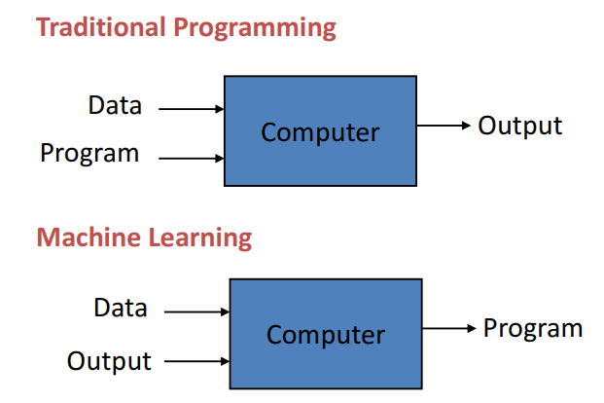
Machine Learning vs Traditional Programming

Slide 5
Types of Machine Learning
Supervised learning
– Given: training data + desired outputs(labels)
Unsupervised learning
– Given: training data (without desired outputs)
Reinforcement learning
– Rewards from a sequence of actions

Slide 6
Supervised Learning Algorithms
Common classification algorithms include:
❖ Support vector machines (SVM)
❖ Neural networks
❖ Naïve Bayes classifier
❖ Decision trees
❖ Discriminant analysis
❖ Nearest neighbors (kNN)
Common regression algorithms include:
❖ Linear regression
❖ Nonlinear regression
❖ Generalized linear models
❖ Decision trees
❖ Neural networks

Slide 7
Unsupervised Algorithms
❖ K-means clustering
❖ Principal Component Analysis (PCA)
❖ Gaussian Mixture Models (GMM)
❖ Self-organizing Maps (SOM)
❖ Hidden Markov Models (HMM)

Slide 8
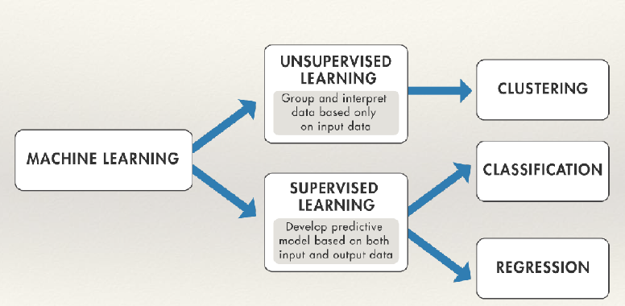
Supervised / Unsupervised Algorithms

Slide 9
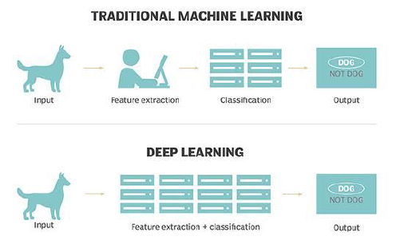
ML vs DL

Slide 10
Working Procedure of ML
Step 1: Get samples (training data)
Step 2: Pre-process the training data
Step 3: Choose an algorithm
Step 4: Train the algorithm
Step 5: Getting predictions
Step 6: Evaluation

Slide 11
Model Evaluation
Classification Metrics
Confusion Matrix
Accuracy
Precision
Recall
Area Under Curve
ROC Curve
F Measures

Slide 12
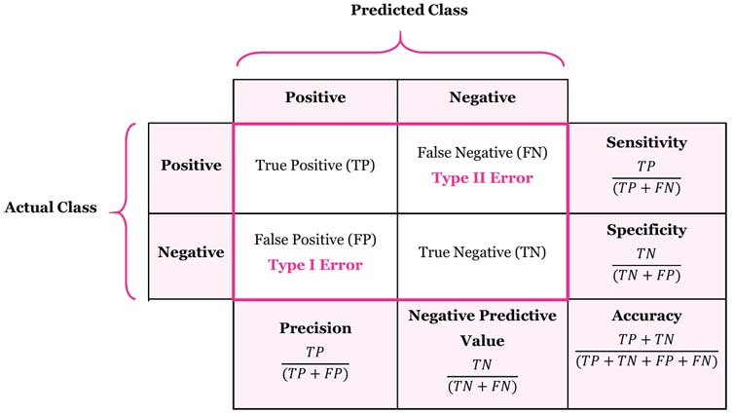
Confusion Matrix for Binary Classification

Slide 13
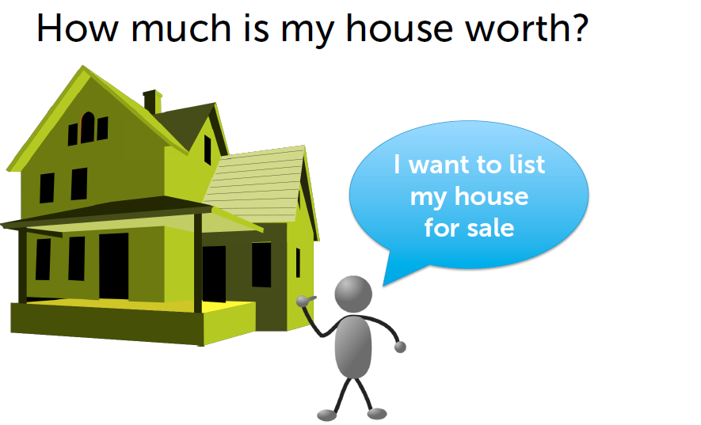
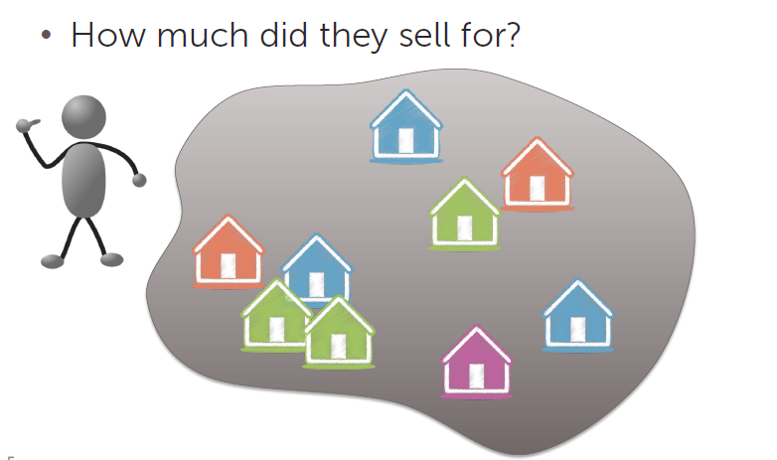
ML Case Studies

Slide 14
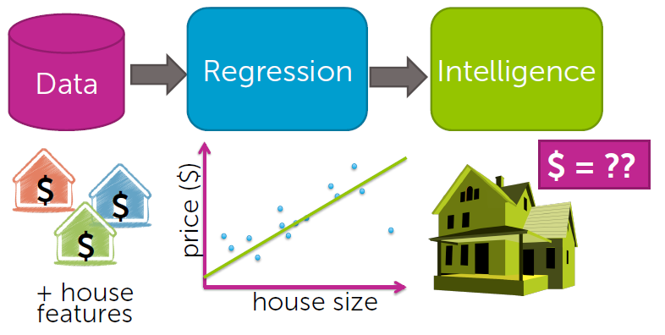
ML Case Studies
CASE STUDY 1: Predicting House Price

Slide 15
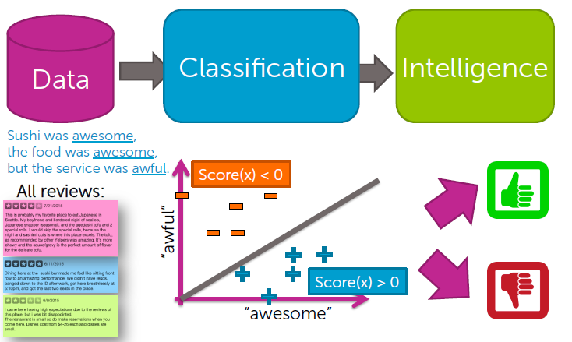
ML Case Studies
CASE STUDY 2: Sentiment Analysis

Slide 16
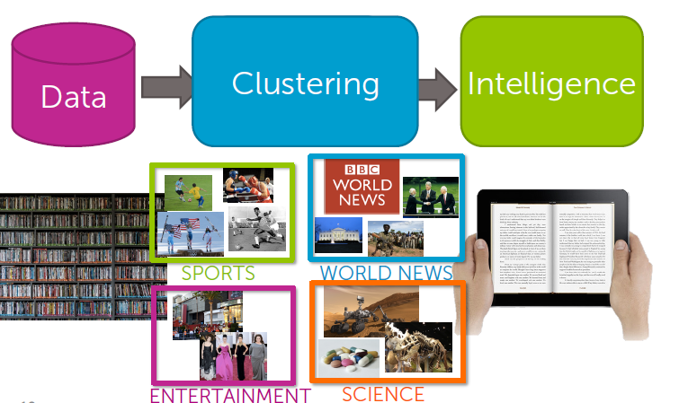
ML Case Studies
CASE STUDY 3: Document Retrieval

Slide 17
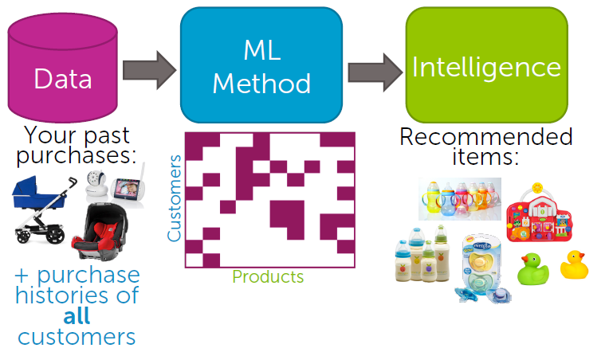
ML Case Studies
CASE STUDY 4: Product Recommendation

Slide 18
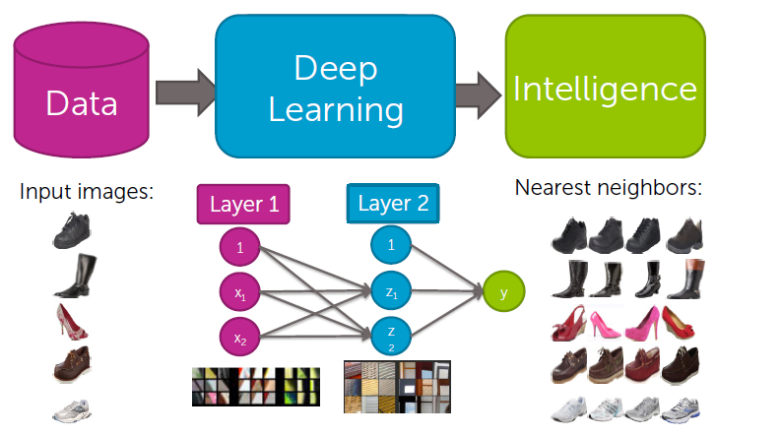
ML Case Studies
CASE STUDY 5: Visual Product Recommendation

Slide 19
Need Math Background?
Basic calculus
- Concept of derivatives
Basic linear algebra
- Vectors
- Matrices
- Matrix multiply Basic statistics: such as mean, median, mode, standard deviation, variance, range, percentiles, quartiles, probability distribution, time series analysis etc.

Slide 20
Programming Experience
Programming Language:
- Python
ML/DL Tool Kits:
- Scikit-Learn
- Tensorflow
- PyTorch
- Keras

Slide 21
Where We do ML Code
Off - Line Platform:
Anaconda: https://www.anaconda.com/products/individual
Pycharm: https://www.jetbrains.com/pycharm/
Online Platform:
Google Colaboratory: Google Colab: https://colab.research.google.com/notebooks/intro.ipynb
Jupyter: https://jupyter.org/

Slide 22
Google Colab
Based on the open-source project Jupyter
IPython is the default kernel for colab, and it provides a more interactive Python shell
Suitable for machine learning, data analysis, and other tasks that require access to heavy computer resources
Colab is free with limited facilities, and the premium version is available with unlimited facilities.
No setup is necessary, like zero configuration
Easily sharable with team members to collaborate.
Colab notebooks are stored in Google Drive
Colab notebooks execute code on Google's cloud servers, meaning we can leverage the power of Google hardware, including GPUs and TPUs
Generative AI is integrated for coding help
Notes:
Use Jupyer kernel: by default, use the Ipython kernel. The kernel is the computational engine or the driving force behind the code execution in Jupyter notebooks. It empowers you to execute code in different programming languages such as Python, R, or Julia and instantly view the outcomes within the notebook interface. IPython is the default kernel for colab, and it provides a more interactive Python shell. It includes interactive data visualization, shell syntax, and inline documentation.

Slide 23
Questions?

